Slide 1
The Oats Markets Alberta 2019/20/21/22
Presented by: Chris Newbergher,
Grain Marketing Specialist, Stony Plain Seed Cleaning Association

Slide 2
Year in Review 2019/2020 – one word - WOW!!!!!
The 2019/2020 harvest was once again plagued by damp to wet conditions; just like the previous 4 years. This affected the overall quality of the oat harvest across most of Alberta. In fact, many thousands of acres were left unharvested which brought us another challenge,….. Spring Thrashed oats.

Slide 3
Oat prices in 2020 were historically high!!!! I have been buying oats for 15 years and have NEVER seen prices this high.
I returned to Stony Plain Seed in January of 2020.
Oat prices were as follows: 2 CW Oats: $ 3.00/bushel
3 CW Oats: $ 2.50/bushel
Spring Thrashed Oats: $ 2.00/bushel
By the end of 2020 (July), our prices were as follows:
Oat prices were as follows: 2 CW Oats: $ 4.25/bushel
3 CW Oats: $ 3.75/bushel
Spring Thrashed Oats: $ 3.25/bushel

Slide 4
Why were the prices so high?
Simple,…. Less good quality oats for pony and milling markets. More buying competition.
In 2019/2020, the oat quality was not stellar and many of the milling companies were scrambling to find suitable product. In fact, many of the local companies ran short on supply and were forced to buy from line companies at inflated prices. In addition, there were shortages in other Provinces which led several companies actually poaching local supplies. We were supplying oats as far east as Ontario & Quebec.

Slide 5
By the numbers: Oats Acres in Alberta: 2014 = 670,000 = 23.7% 2015 = 670,000 = 20.0% 2016 = 720,000 = 25.1% 2017 = 690,000 = 21.6% 2018 = 795,000 = 25.6% 2019 = 899,000 = 24.9 % 2020 = 881,000 = 23.2% Alberta has averaged approximately 23.4% of all seeded oat acres in Canada since 2014. Oats acres in 2021 expected to dip by approximately 3-5%. Saskatchewan Averaged 50% of total production and Manitoba Averaged 14% of total production during the same period.
Numbers:

Slide 6
What are your yields???
According to Statistics Canada, the average yield for oats in Alberta is 93 bushels, Saskatchewan is 91 and Manitoba is a whooping 110!!!!. For producers who take oats “seriously”,…average yields are much higher, usually closer to 120-140 bushels per acre.
For some regions of the province such as the “Peace Country”; oats are treated as a cash crop with high value returns.
Preferred varieties: Morgan, Derby are the old guard for oats but Camden and Summit appear to be making headway with seeded acres in Alberta. Some forage varieties such as Mustang are still very popular for feed & pony oats market.

Slide 7
2020/2021 Oats Crop – Prices
WOW (AGAIN!!!)
Acres we higher in 2020 BUT a VERY wet spring prevented many of the “intended” acres from being planted or those that got planted actually drowned out. Fortunately, OATS is a very hardy crop and a good percentage survived albeit with lower yields. This was one of the BEST harvest conditions in MANY years unfortunately yields were much lower then expected on ALL crops.
Great harvest conditions allowed most farmers to finish everything in 2-3 weeks. Grade qualities were excellent for most of the crops. Very few “feed grains” were available like typical years so feed prices started to rise immediately with barley leading the way. Little to NO feed wheat or oats.

Slide 8
2020/2021 Oats Crop – Prices WOW (AGAIN!!!)
Oat prices in 2021 started off at traditionally normal levels but quickly escalated due to millers trying to get ahead of higher prices down the road. I have been buying oats for 15 years and have NEVER seen prices this high. But like other crops, what goes up,…must come DOWN.
Harvest time 2020/21
Oat prices were as follows: 2 CW Oats: $ 3.10 – $ 3.25/bushel
3 CW Oats: $ 2.50 - $ 3.00/bushel
Spring Thrashed Oats: $ 2.00/bushel
As of 19 March:
Oat prices were as follows: 2 CW Oats: $ 4.50 - $ 4.75/bushel
3 CW Oats: $ 3.75 - $ 4.25/bushel
Spring Thrashed Oats: $ 3.50/bushel
Prices as of 29 March are dropping fast. Local millers are all covered and have reduced pricing by $ 0.50 - $1.00/bushel. We expect pricing to drop again once seeding is done.
Prices were only staying high in order to compete for acres but with acres expected to decline by 3-5% this year there is no longer any pressure to fight with barley or canola. Even with the lower acres, if yields are normal, there will be ample supply. There should be NO pricing frenzy unless there is another weather event.

Slide 9
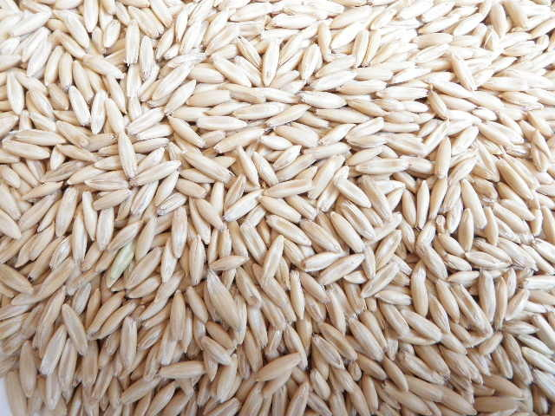
Where can you sell your oats???
Markets
The primary markets for oats are as follows:
Pony or Racehorse Oats:
High end pricing – visually
VERY nice looking. Horse
owners are VERY fussy so
quality is tightly
controlled. Cleaned to
high tolerances.

Slide 10
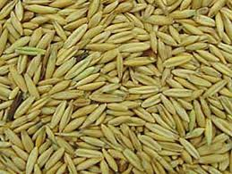
Where can you sell your oats???
Markets
Milling (Human Consumption):
Good pricing – visually can be
Darker provided “groats” are
sound and good colour.
Can also be used in “high-end”
pet foods.

Slide 11
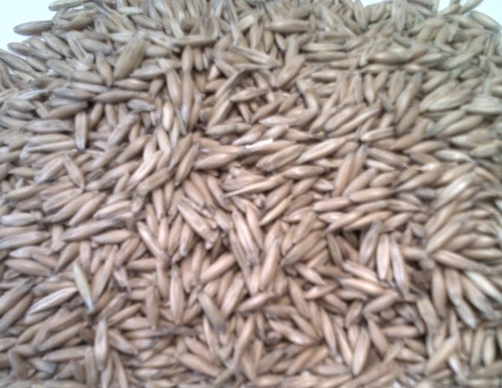
Where can you sell your oats???
Markets
Feed Oats:
Lower pricing – visually can be
Darker or even stained. Thinner
light weight oats. Used in feed
rations, prepared mixed feeds,
and low end pet food.

Slide 13
Positive Market Forces
Dietary trends throughout North America, Europe and Asia continue to fuel exports. Middle East becoming a stronger market as well. (Dubai)
Countries such as Japan, China and Korea have shown increased interest in oat based foods and snacks.
South America increasing use, trouble with supply because of weather can be a problem.
Strong Feed Prices push the price of oats UP.
New products making large gains; Oat Milk, Oat Groats.
New varieties and increased “domestic buying” competition.
Cheaper to produce then other crops. Good return.

Slide 14
Negative Market Forces
More “Millers” demanding “glyphosate free” oats due to consumer perception. Creates harvest pressure.
High domestic pricing reducing overseas purchases.
Frequently $ 50-60.00/mt over other quotes.
Losing market share.
High end race horse markets subject to “luxury” risks.
Competition for acres with other crops; barley or canola.
Foreign oat growers are VERY aggressive when supply allows.
Australia and South America (Chile) are our biggest competitors.

Slide 15
The Buyers Perspective
The buyer
Many producers DO NOT make oats part of their “normal” rotations. Oats are still considered a specialty crop.
However, from an “oats buyers” perspective it is VERY important for us to have a stable source of supply & quality. Some producers move oats in and out of production every few years so it can be difficult for “oats buyers” to have reliable supplies. If you commit to producing oats on a regular basis and get to know the main buyers, you will be able to maximize your ability to profitably market your oats.

Slide 16
Crop Planning & Marketing Options
In order to avoid possible shortages, some Milling companies utilize production contracts with “act of god” clauses with growers to mitigate risk and secure supply.
Take really good representative samples. Keep in sealed 5 gallon pail with lid. Use grams/half litre.
When forward contracting oats NEVER do more then 25%.
Glyphosate restrictions – know your buyer.
Know your buyers and the best varieties for marketing to your strengths. Morgan is still the “king of oats” in Alberta but is beginning to lose ground due to it’s lower beta-glucan” content.
Treat oats as a cash crop!!!!!
Options

Slide 17
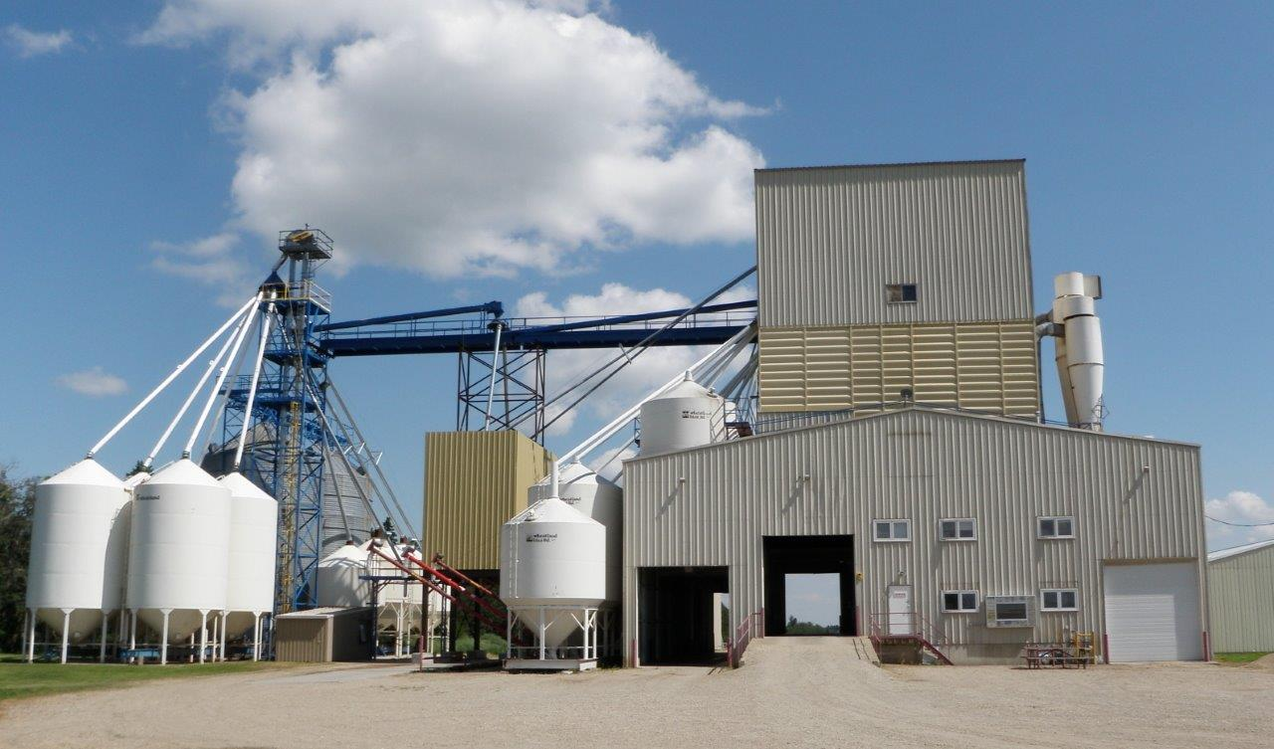
Who is Stony Plain Seed?
Stony Plain Seed was established in 1954 primarily as a municipal seed cleaning plant. SP Seed established a commercial division to service domestic and export clients when it moved to it’s current location in 1986.
With more then 35 years experience in buying, processing and shipping oats, we have developed markets all over the world.
We can forward contract oats.
Our specialty is Oats and we pride
ourselves on personalized service.
Flexible and easy to work with.

Slide 18
Pricing Predictions 2021/22
Feed Oats: $ 3.00 – 3.50 /bu.
2CW/Milling/PONY Oats:
$ 3.50 - $ 4.00/bu.
These prices are delivered to the facility.

Slide 19
Conclusion -Why Oats???
If you yield 130 bushels per acre (which is very attainable), you will produce approximately 2 mts per acre.
If you are being paid, $ 4.00/bushel you would make approximately $ 518.00/acre. When you subtract input costs it is still one of the most profitable crops available with lower risk.

