Slide 1
What Changes with the Implementation of Bill C-49 and How Might it Impact Producers
CropSphere 2019
January 15, 2019

Slide 2
Why?
“The first step in solving a problem is recognizing there is one”

Slide 3
Background
Transportation has been a public policy matter from the earliest days of Confederation
  Began with canals and railways
  Expanded as technology fostered new modes of transport
    Road, air and pipelines
Activity overseen through government regulation
  Government charters and licensing (federal and provincial)
  Rooted in common-carrier obligations
    Focused on rates and service standards

Slide 4
A Brief Regulatory History …
1895
Railway Rates
1897
Crows Nest Pass Agreement
1901
Montreal Grain Inspectors
1888
Galt
1908
on Grain Trade
1917
Sintaluta
1959
Bracken on Costs
1943
CWB
1954
CWB Act
1961-62
McPherson
1975
Snavely
1975
Hall
1982
Gilson Report
1984
WGTA Established
1995-96
Crow eliminated
1995
WGTA disbanded
1998-99
Estey/ Kroeger
CTAR 2001
Fair Rail for Farmers 2014
Removal of CWB Single Desk 2012
CTA Act Revision 2004
Rail Freight Service Review 2008
Shipper Protection 2010
CTAR 2015
2000-01
CTA 2000
Notes:
Reforms recommended following review in 1998-99
Replace rate scale with Maximum Revenue Entitlement (MRE)
Introduce more commercial mechanisms for car allocation
Retain an independent third party to report on GHTS activity
Quorum awarded “Grain Monitoring” contract in 2001
Transportation and logistics consulting firm
Focused on surface transportation: road, rail and marine
Bulk and non-bulk commodities
Experienced in database management
Contract renewed several times, most recently in 2017

Slide 5
The Burdens of Regulation
Slow to respond to changing circumstances
Crisis of the 1970s led to sweeping reforms
  US - Staggers Act (1980)
  Canada – National Transportation Act (1987)
Heavy government involvement in rail movement
  Crowsnest Pass freight rates (1897)
  Reinstated after WWI and then made statutory in 1927
  Inflation steadily eroded grain’s profitability
Railways were refusing to invest in grain-related plant and equipment (circa 1960)
  Led to government assistance: public hopper-car fleet; branchline rehabilitation
  Rate reform: Western Grain Transportation Act (1983)
Notes:
Slow to respond to changing circumstances
Ignored wider economic and competitive realities
North American railways in financial distress by 1950s
Crisis of the 1970s led to sweeping reforms
US - Staggers Act (1980)
Permitted mergers, line abandonments and service cuts
Allowed US carriers greater commercial freedom
Widely credited with restoring financial health of US carriers
Canada – National Transportation Act (1987)
Followed US lead in deregulating the industry
Loosened further in 1996 under Canada Transportation Act

Slide 6
Grain Transportation in Canada
Heavy government involvement in rail movement
  Crowsnest Pass freight rates (1897)
  Inflation steadily eroded grain’s profitability
Railways were refusing to invest in grain-related plant and equipment (circa 1960)
  Led to government assistance: public hopper-car fleet; branchline rehabilitation
  Rate reform: Western Grain Transportation Act (1983)
    Gradual increase in “Crow Rate” and direct government subsidies
    Eliminated with a one-time payout to farmers (mid 1990s)

Slide 7

So What is Driving the most recent Legislative Change?

Slide 8
Issues
Availability of Railway Capacity
  Grow the pie – don’t split it differently
Railway service: Consistency, Timeliness and Resilience
  The need for reliable and consistent service
Access to broader markets
  An economic means to reach untapped US markets
An approach to measuring Railway performance (Data)
  Only the Grain industry has it
The replacement of the Federal Gov’t hopper car fleet

Slide 9
Total Grain Supply
(Western Canada Production and Carry-In Stock)
Avg. 79.1 MMT
Avg. 61.1 MMT
Avg. 63.5 MMT
Avg. 53.7 MMT

Slide 10
Western Port Volumes
Notes:
With shifts in the market from Europe and FSU to Asia Pacific and South and Central American, the dominant gateway has become the west coast, and it is expected that will continue over the next 10 years

Slide 11
Canadian Grain Markets

Slide 12
Order Fulfilment – CN
2013-14 – Railway Reported; 2015-18 – ATC Reported

Slide 13
CN Supplied Cars – 2017-18 CY
Source: CN weekly supply reports; ATC Weekly Reports

Slide 14
Order Fulfillment - CP
2013-14 – Railway Reported; 2015-18 – ATC Reported

Slide 15
What was Bill C-49?
The Transportation Modernization Act
  An Act to amend the Canada Transportation Act and other Acts respecting transportation and to make related and consequential amendments to other Acts
  Covers both Rail and Air legislation
Impact on Grain industry
  Rail Service Issues
  Railway investment
  Transparency (data)

Slide 16

Reciprocal Accountability
Presently there is little or no accountability for railways to perform
Service Agreements between Shippers and the Railways with penalties for non performance
  Includes service standards
Mediation processes in development

Slide 17
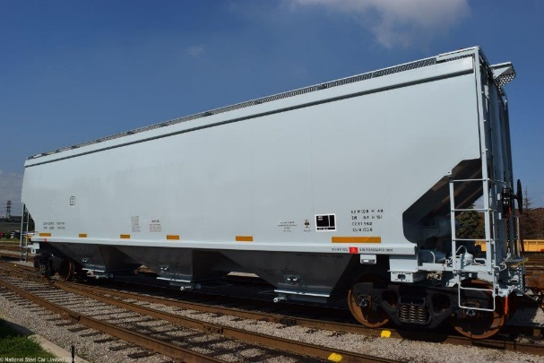
Railway Investment
Modify the MRE
  Split the VRCPI to two railways (rather than blended)
  Allow greater advantage for depreciating/ including cost of new cars
Removes risk of complacency - Increases incentive to invest
In place for 2018-19 Crop year

Slide 18
Long Haul Interswitching (LHI)
Extended Interswitching was introduced as part of the “Fair Rail for Farmers” Act in 2014.
As emergency legislation, required to be renewed after 2 years, and was extended to August of 2017.
LHI was the replacement
Allows, under tighter conditions, for a shipper to apply for rate from the CTA for the movement of traffic to a second carrier
Dependent on the failure to reach an agreement with the serving carrier and subsequent approval from the CTA
Approval processes still in development

Slide 19

Data Transparency
Reporting in line with STB approach
  Published weekly on TC website
  Includes basic volume and performance stats
  To be refined over the next 18 months
Waybill data reporting for the CTA to use in developing LHI rate structures

Slide 20
What does this mean for Producers?
Increased Rail Capacity ?
Greater reliability in Rail Service ?
More competition between Grain Companies?
Greater confidence in Canada as a supplier of grain products ?

Slide 21
Supply Chain Relationships
Generic Supply Chain Model
Relationships
Money Flow
Production/ Manufacturer
Transportation
Provider
Distributor
Transportation
Provider
Distributor
End User/ Buyer
Canadian Grain Supply Chain Model (Bulk through Grain Company)
Producer
(Truck (Owned or hired)
Grain Company (Country)
Railway
Port Terminal
End User/ Buyer
Shipping Line

Slide 22
Grain Companies position in the Market
Grain companies generally do not market grain based on global market demand but on what rail capacity they think they can obtain.
By extension, the competition for producers grain is impacted by what cars their local elevator is allocated by the railway that serves them.
Will the advent of greater accountability on the railways increase rail capacity, and consequently greater competition between grain companies for producers grain?

Slide 23
Country Elevator Network
(Primary and Process)
Elevators & Delivery Points

Slide 24
Canadian Grain Logistics in the Global Market
Length of haul to port of export
Brazil: 100 – 150 miles (Truck 90% ++)
Australia: 150 – 250 miles (Truck 50%/ Rail 50%)
United States: 350 - 600 miles (Rail 60%+, Truck –Barge)
Canada: 790 – 1,150 miles (Rail 95%, Truck 5%)
Agriculture dependency on Exports (% of Crop Exported)
Brazil: 39% (74 M of 187 M)
Australia: 23% (17 M of 74 M)
United States: 16% (82 M of 500 M)
Canada: 55% (52 M of 95 M)
Other Issues
Climate
Distance to market (ocean)
Relative market position (size)
Covers all field crops exported against total grains production)

Slide 25
Impact of New Hopper Cars and Operating Plan
New car fleet will provide higher loading capacity
  Shorter cars 57 ft vs 60 ft (more cars/ train)
  3 hopper vs 4 (less maintenance)
  Centre sill vs box sill (greater stability)
  5,300 cu ft vs 4,750 cu ft
  100 T per car vs 90 T
New operating scenario sees CP moving to a 8,500 ft train (from 7,000); CN to 134 – 180 cars
Loop track design in country for 134 to 150 cars
G3 Terminal is designed for 150 cars
+67% - CN
+49% - CP
+49% - CN
+33% - CP
+ 11%
Notes:
Part of the deal in the MRE adjustment in C-49 is that railways get credit based on a tonne capacity basis as opposed to a car for car basis (as it was prior to C-49). For example, they can buy 8 cars they can scrap 9-10 Govt cars. Consequently, it is not clear what the ACTUAL increase in overall capacity will be.
Further, as Wade has been pressing them and the Government on, they have held at the “Maximum Grain Supply Chain Capacity” limit of 5,500 and 4,000 (cars per week) level for about 5 years now, although the average annual increase in export volumes has been running at 3%. I did some calculations and based on the existing car cycles at 16 days plus, they don’t have enough cars to maintain that. (They need 14.5 days or lower). It wasn’t a problem two years ago because they were averaging 13.5 days but the past 18 months, they only hit that level in two months.
While the last couple of months, CP has been beating that number, CN has not. Cn has seen numbers in the 18 day + range, while CP has stayed around the 16 day mark.
The last two months have seen a return to the mid 14 day range, however, that will like shoot up over the next few months

Slide 26
System Improvements/ Changes
Prince Rupert Indexer replacement
AGT Gallery and loader replacement
G3 startup
  Access to North Shore
  Capacity through the tunnel
Increase in country primary elevator capacity and facilities
Churchill line and terminal purchase

Slide 27
Key Observations from the GMP
2018-19 Second highest grain supply ever at 81.2 MMT
  2017-18 now the third highest at 80.5 MMT
Despite that, 17-18 volumes were down from previous year:
  Elevator throughput down 3.2%
  Rail movements down 4.2%
  Shipments down 6.2%
Rail Performance fell:
  Car cycles and loaded transit has increased – 14.7% & 18.7%
  Most predominant component is origin dwell – increased 116.5%
  Order fulfillment rates have fallen
Vessel time in port increased 4.7%
Stock in country have held at over 4 MMT, highest ever

Slide 28
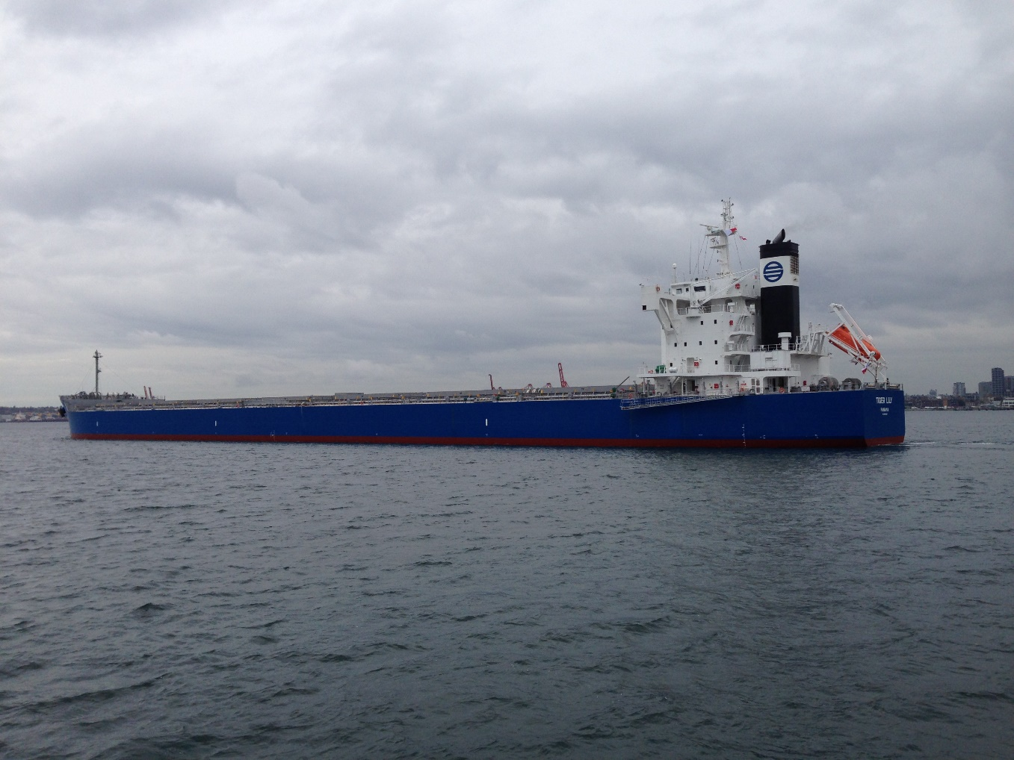
Issues of Concern

Slide 29
Western Canadian Car Cycles
(2017-18 Crop Year)
Western Canada
15.7 days
(LY = 14.1)
Eastern Canada
24.2 days
(LY = 20.9)
United States
27.9 days
(LY= 24.8)
16.2
(13.8)
28.1
16.3
(14.3)
13.3
23.3
27.1
39.4
37.9
31.3

Slide 30
Car Cycles – West Coast
Vancouver +14%
Prince Rupert +18%

Slide 31
Railway Capacity
Rail performance:
  Increased car cycles/ dwell times/ reduces capacity
  Reduced capacity impacts order fulfillment potential
  Constricted rail volume impact vessel time in port
  Railways are addressing issues:
    Increased running trades hiring
    Purchase of locomotives
    Capital programs increasing track capacity
Competition with other commodities by corridor
Fleet requirement for 5,500 cars/ week
(based on variable car cycle)
Cycle Time | Required Fleet
18.00 | 14,709
16.00 | 13,074
14.00 | 11,440
Present Fleet
CN | 12,100
CP | 11,400

Slide 32
Average Vessel Time in Port
Notes:
… and that is the time vessel lay in port .
… over ten years the average was 6-8 days when in early 2011 we started to see rapid increases … hitting a high of almost 29 days on average in the winter of 2013-14. Now put the two together – as many as 38 vessels sitting in port on an average of 29 days each.
So what happened?

Slide 33
Average Vessel Time in Port

Slide 34
Other Issues
Loading in the rain (Vancouver)
  ILWU contract negotiations
Impact of pilotage review on Seaway movements
CP elimination of 56 car rate
  Part of CP’s 8,500 foot train strategy
  May give allowances to certain shippers
  Approximately 12% originates from 56 car loaders
  Impacts 34 facilities

Slide 35
MRE Differentials
% of total Revenue

Slide 36
Shipments from Canada

Slide 37
Western Canada Grain Supply
1999-2018 Actual; F’cast to 2030
Notes:
Two scenarios here
- While average growth over the last 10 years has been about 3%, I went 2.5% and 1%, which is what the 30 year average is
- Essentially it suggests that by 2030 we’ll be at between 90 and 100 MMT annually of grain supply

Slide 38
Weather
The number of days temperature levels fell below -25 C (Railway Level 1 Winter operations) was at or near average with the exception of February
Levels in 2017-18 were far less drastic than those seen in 2013-14

Slide 39
Summary
Too soon to tell if the C-49 amendments will make a difference.
  Processes have yet to be defined
  Will be followed with legal challenges setting precedents for future use
Impact on producers is not clear
  Dependent on how the competitive marketplace evolves
The greater impact for producers will likely be the expansion of the country network by both existing grain companies and new entrants.

Slide 40
Thank You
Reports Available
Website: www.grainmonitor.ca

