Slide 1
SaskOats 2023
Oat Market Outlook
Satart

Slide 2
Outline
2022 events in review
Balance sheet review global setting & Canada
Global oats – big picture
N American & Cdn. balance sheets
Changes in demand
YTD exports
Outlook

Slide 3
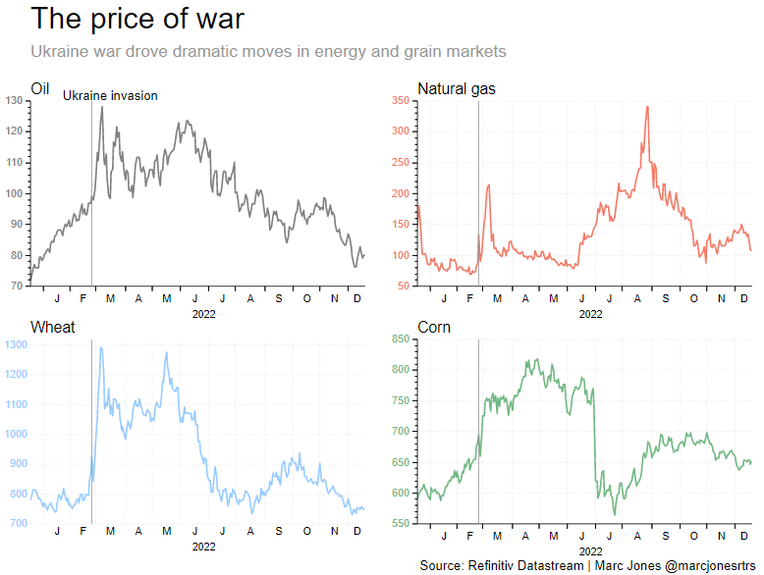
2022 in review:
Russian invasion of Ukraine (Feb.24/’22)
Economic woes
  Post-Covid effects
  Energy jump/ inflation
Refugee movements (EU)
  Syrians, Ukrainians
New geo-political era
  Sino-American rivalry
  Russia starving Europe of fuel

Slide 4
“ 2022 “ – ‘outside factors of influence’
January: High commodity prices
February: Russia invades Ukraine; high futures
March: Diesel px up; fertilizer imports slowed; BoC rate up
April: Cdn. inflation at 6.8%; wht. above $11/bu; corn $8/bu
May: Cdn. inflation 7.7%; global food pxs rising
June: Increases in prod’n costs; too wet MB
July: 1st Ukr.-Russia port corridor agreement
August: OECD projections to ‘31-32 fed suspicions that crop prices had peaked in the 2021-22 MY; Cdn. infl’n 7.6%
Sept.: USDA proj’d declines in EU corn & wheat prod’n due French drought; EU fertilizer plants closed due lack fuel
Oct.: Mississippi low (92% US ag exports); pot. US rail strike; BoC rate up; Cdn.$ low vs US$
Nov.: Russia suspends grain corridor, then re-opens to mid-March
Dec.: BoC rate to 4.25%; prod’n costs?

Slide 5
Oats

Slide 6
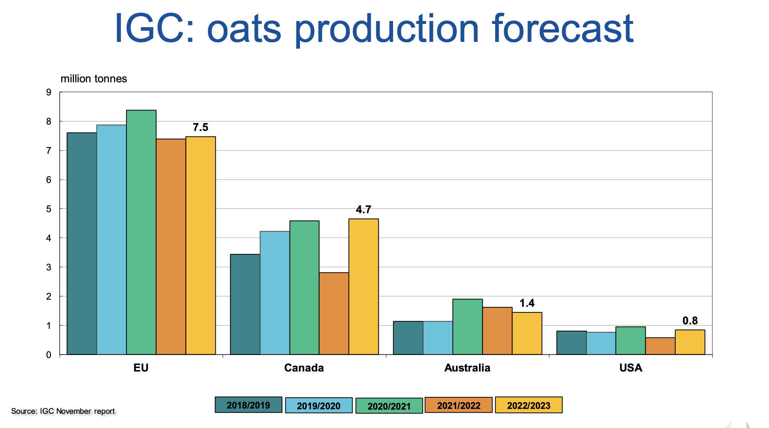
Global oat production

Slide 7
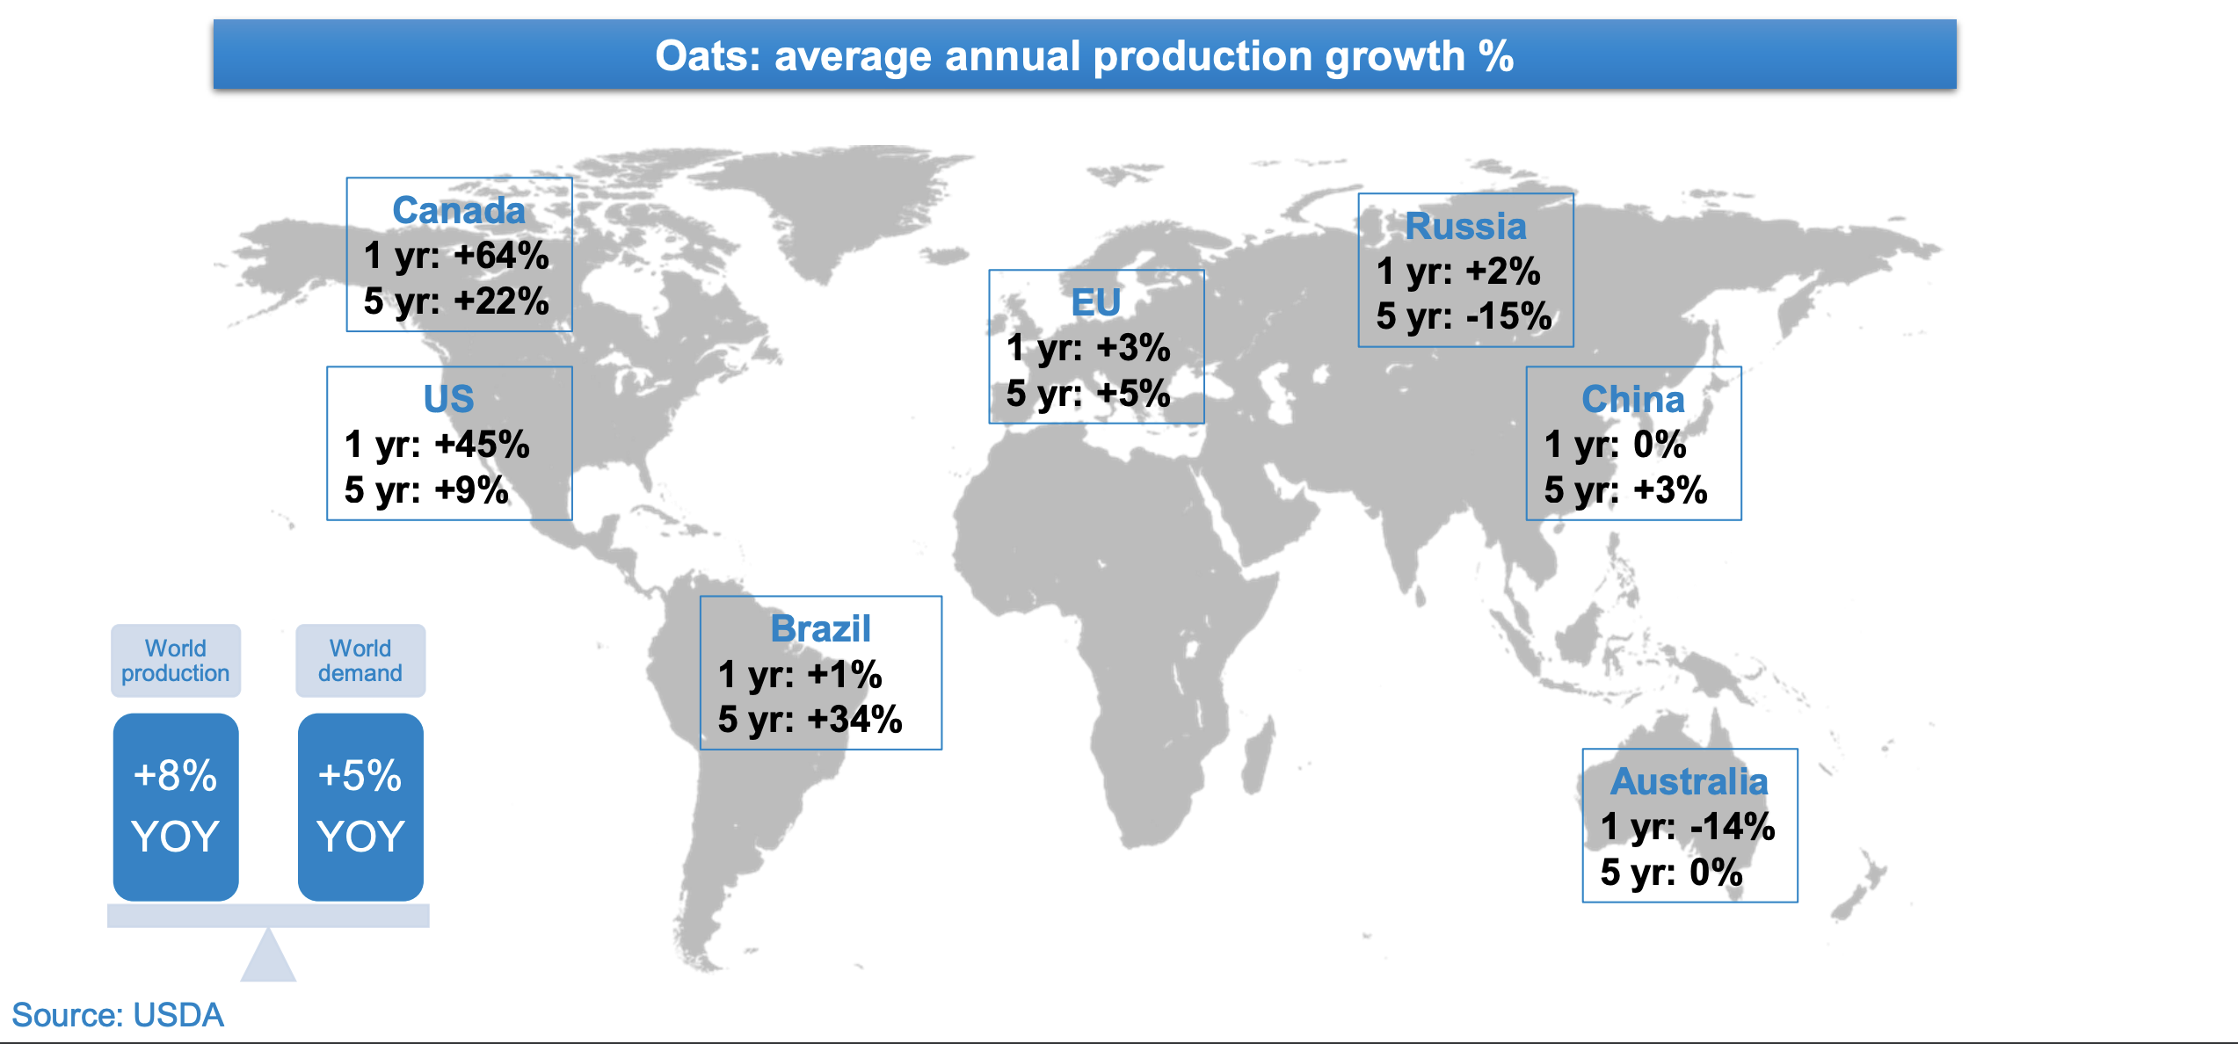
Global oats

Slide 8
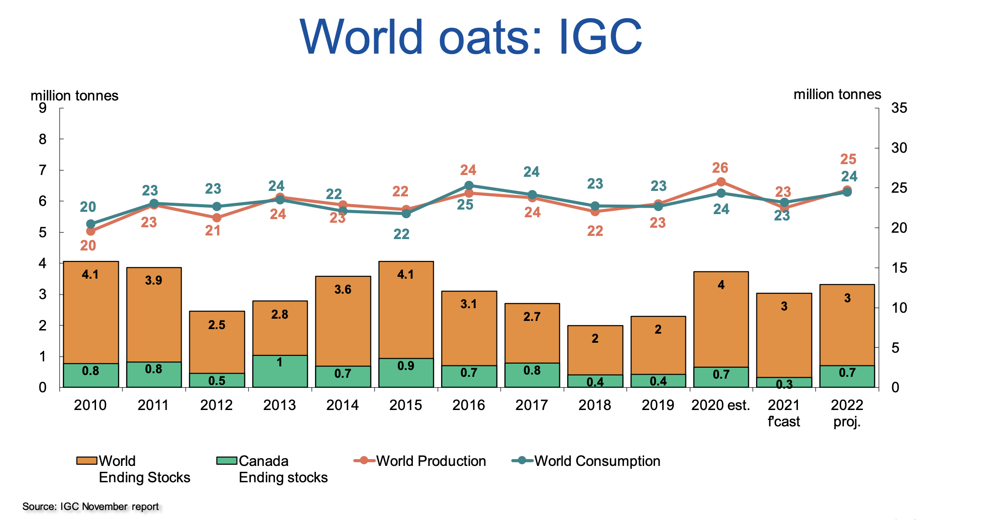
Global oat balance sheet
Notes:
ICG Cdn. no.lower than STC’s at 5.2 mln mt.

Slide 9
Global Oat summary
Global Prod’n:
Incl. 15-year large crop in Canada (~5.2 mln mt; +86% yr/yr); Global prod’n ~25.3 mlnt (+2.8 mln mt; +10%)
EU prod’n: 7.5 mln mt (+100k mt; +1%)
Russian prod’n: 4 mln mt (+6%)
Global Cons’n:
24.5 mln mt; +5.6% yr/yr
Feed Use: 16.2 mln mt (+6.4%);
Food Use: 5.7 mln mt (1.8%)
Ending stocks: 3.5 mln mt (+9%)
Notes:
CAGR-compound annual growth rate

Slide 10
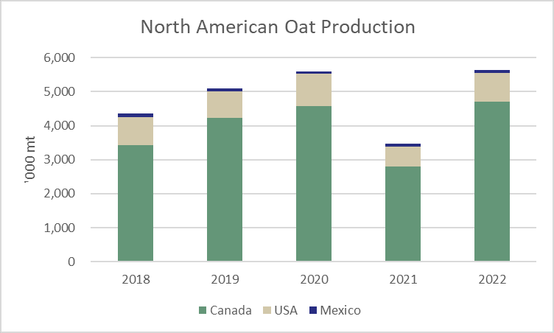
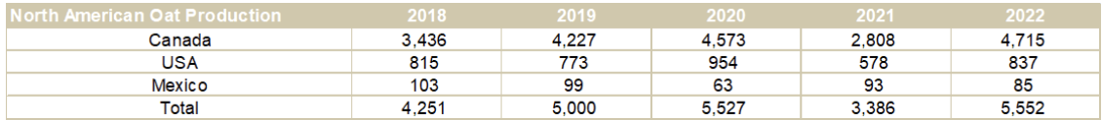
N American oat production

Slide 11
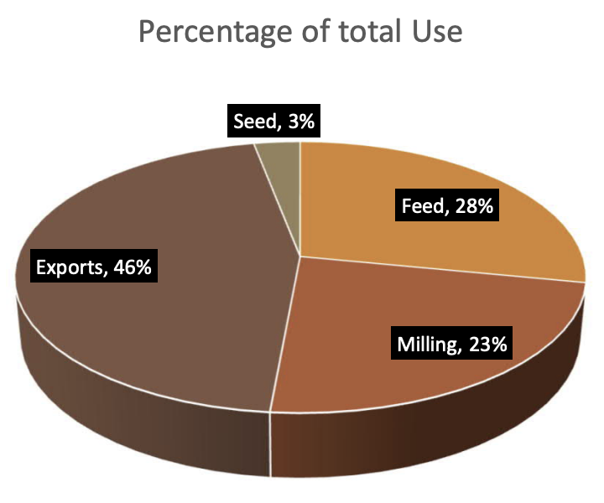
Canadian oats
Oats comprise about 5.5% of total Cdn. production (5.2 mln mt ‘22)
50% of Cdn oats are produced in Sask., 18% in MB, 22% AB/BC, 10% E Cda.
Oat acres have been migrating north (which is away from the US mkt.)
Cdn. usage of oats:
  46% for Exports, 4%CAGR
  28% for Feed, 4% CAGR
  23% for Milling, +6% CAGR
  3% for Seed, 1% CAGR

Slide 12
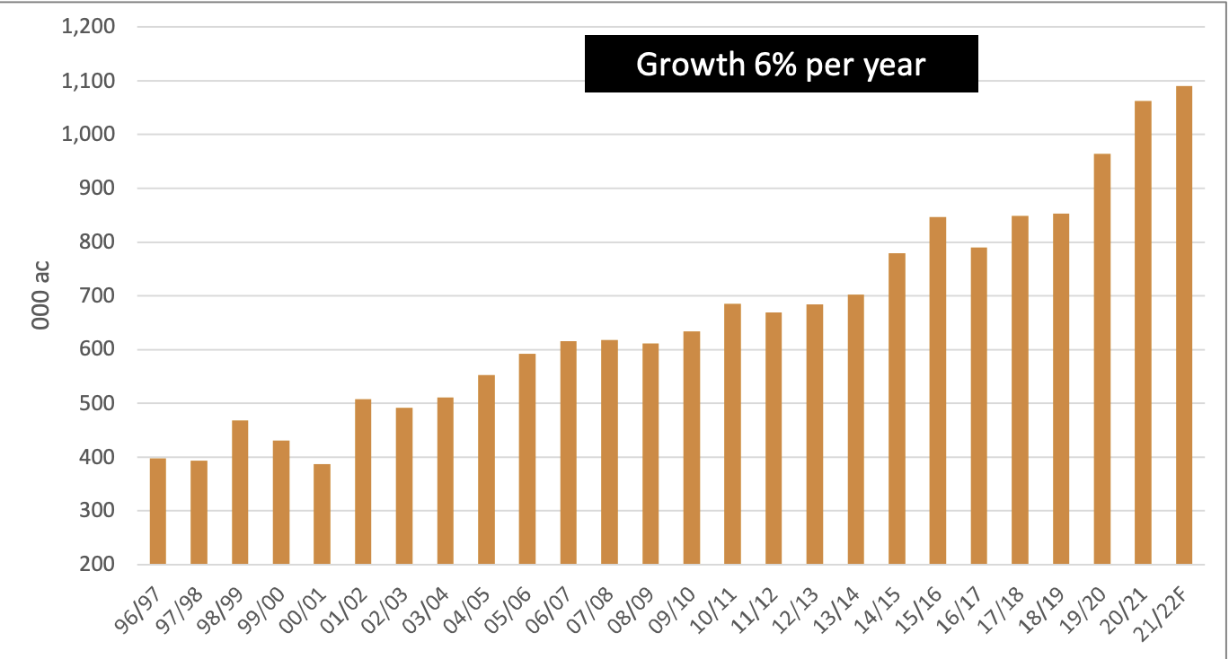
Cdn. Oat Milling usage

Slide 13
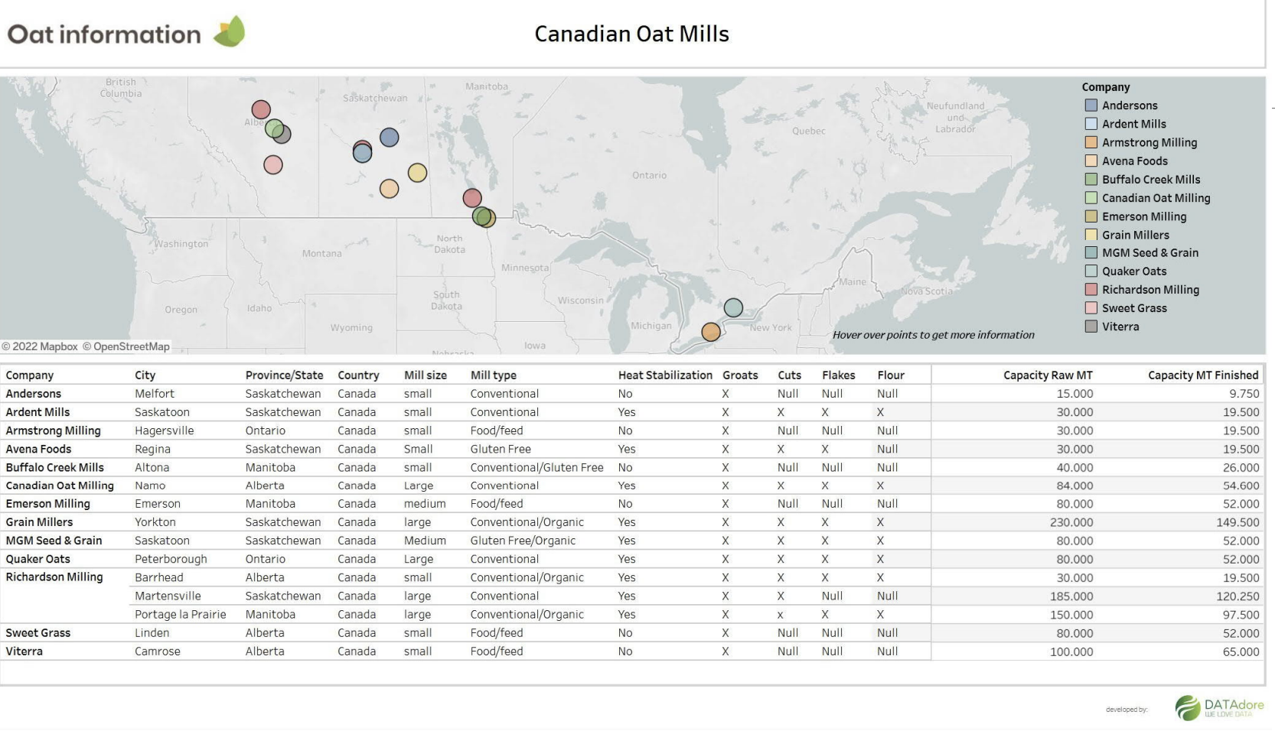
Canadian oat mills

Slide 14
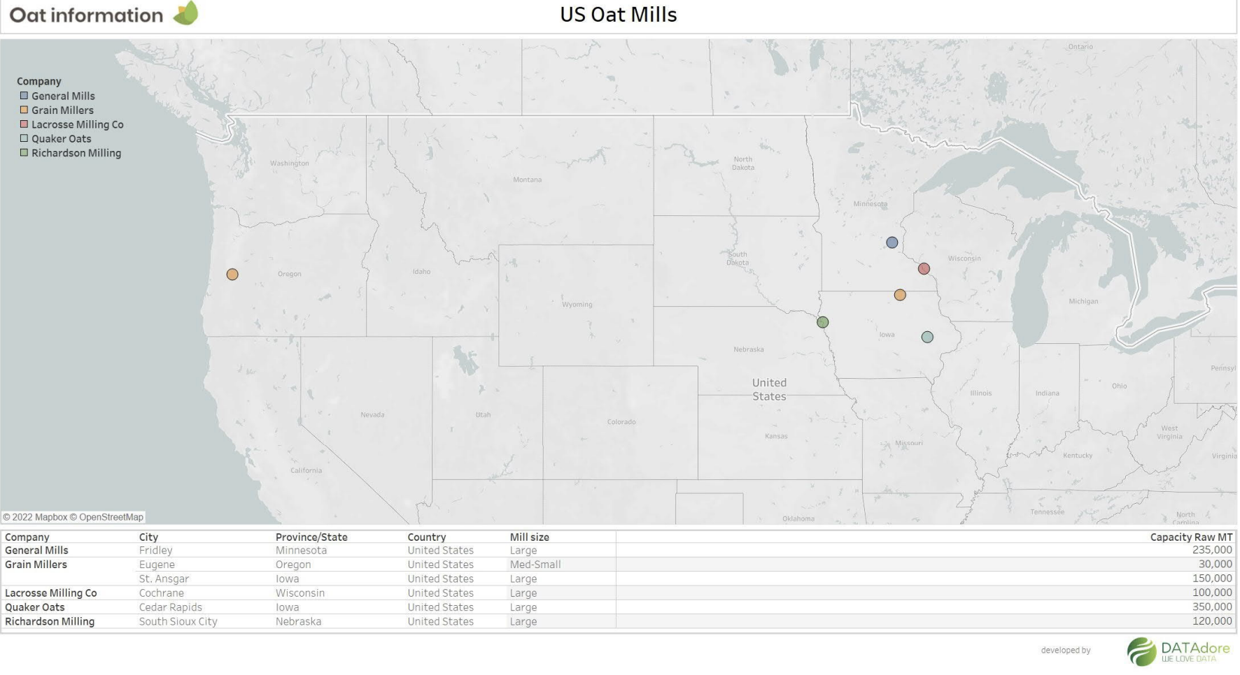
US oat mills

Slide 15
Cdn. oat balance sheet
Notes:
‘20/21: 3 mln mt incl. X S AM.

Slide 16
Ending stock developments

Slide 17
Oat Usage developments
Commercial milling oat use relative to total oat supply had been steadily climbing, going from 6% in 1994-95 to 27% in 2020-21, and is still increasing.
Increasing demand, especially for fiber-rich and gluten-free oat snack products along with the emerging dairy-free beverage sector, set the stage for long-term price volatility.
New and planned builds in Canada have created increased competition for primary oat millers and price benefits for oat product buyers.
  Paterson O-plant nr. Winnipeg: 250k mt/ yr; kilned groats, whole oat flour
  AGT oat milling, Aberdeen, SK: 60k mt/ yr.; oat groats, flours and other milled products for plant-based foods, specialty ingredients and feed products.

Slide 18
Oat Usage developments cont’d
Oat concentrate processing plants are also being built to handle the burgeoning demand for oat-based beverages.
  sales of plant-based milks grew five percent in 2019, making up 14 percent of the entire milk category, according to the Plant Based Foods Association.
  the plant-based milk market is growing at a compound annual growth rate of 10 percent and is expected to reach $21.52 billion in 2024, according to Research and Markets.
  while almond milk continues to dominate the plant-based milk segment with a 63 percent share, oat milk is gaining momentum, recently surpassing soy milk to reach the No. 2 spot (Food Navigator, September 2020). U.S. oat milk sales climbed more than 170% during the 52-week period ended Feb. 13, according to Nielsen data.

Slide 19
Oat Milk ….
Very hard to quantify the oat demand spec. for oat milk – came up with 350k mt for US for 2020 ??
Now the fastest-growing plant-based milk in America , although almond milk still dominates from a market share standpoint •
Emits one-third less than C02 in production than dairy milk • “Replacing a litre of dairy milk w/ a litre of oat milk is equivalent to not driving 5km on fossil fuels” •
Oatly now puts their carbon footprint on every carton now.
Biggest, most established, consistent market is in Europe where 30% of EU milk drinkers consume oat milk 2-3x / week
  By 2020, oat milk products include coffee creamer, yogurt alternatives, ice cream, and chocolate.
  But, ‘21 Novozymes survery: 70% of consumers said they would either NOT pay extra, or would only be willing to pay up to 5% more for oat milk than a traditional dairy product
Notes:
(Source: Novozymes)

Slide 20
oat milk …
Aug. 28/’22:
For the first time ever, oat milk was cheaper than whole milk in Germany last month.
In July, German news publication Focus reported that dairy milk prices were rocketing, reaching “historic highs” in supermarkets. Even retailers known for their low prices, like Aldi Nord and Aldi Süd, had increased cow’s milk prices, it reported.
Focus added that most milk prices had exceeded one Euro, and when compared with December 2021, prices for whole milk (also known as full-fat milk) had risen by 29 cents per liter.
This meant that for the first time ever, both oat and almond milk prices were cheaper than whole milk.

Slide 21
Oatly (pioneer in oat milk)
To meet the American demand, Oatly opened a new factory in New Jersey in April 2019, producing 2,800,000 l per month of oat milk base, and announced plans for a Utah-based factory three times larger to open in early 2020.
In 2019, retail sales of oat milk in the United States were $29 million, up from $4.4 million in 2017.
During 2020, oat milk sales in the United States increased to $213 million, becoming the second most consumed plant milk after almond milk ($1.5 billion in 2020 sales).
From 2019 to 2020 in the US, oat milk sales increased 303% to US$213 million, with refrigerated oat milk having nearly ten times the sales of shelf-stable oat milk.

Slide 22
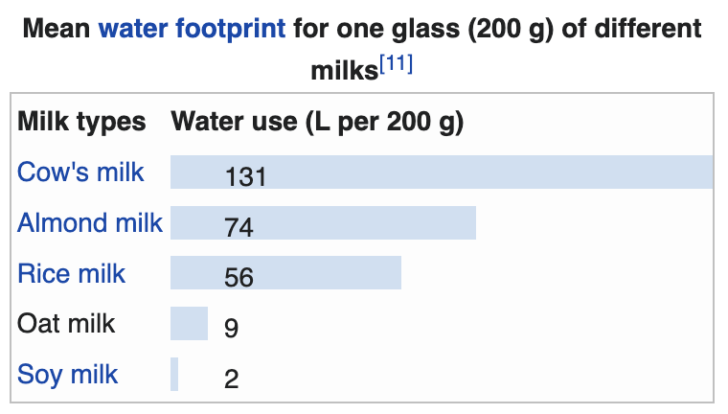
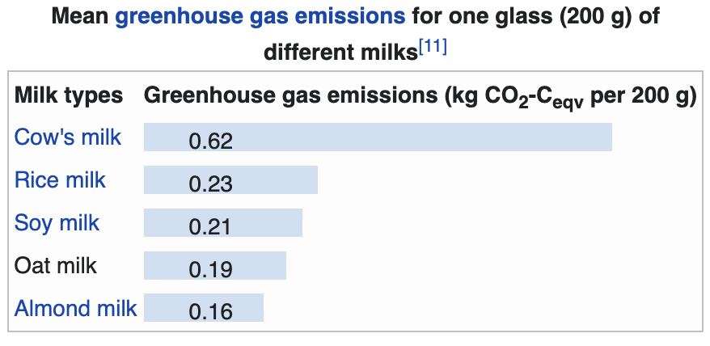
Environmental aspects …

Slide 23
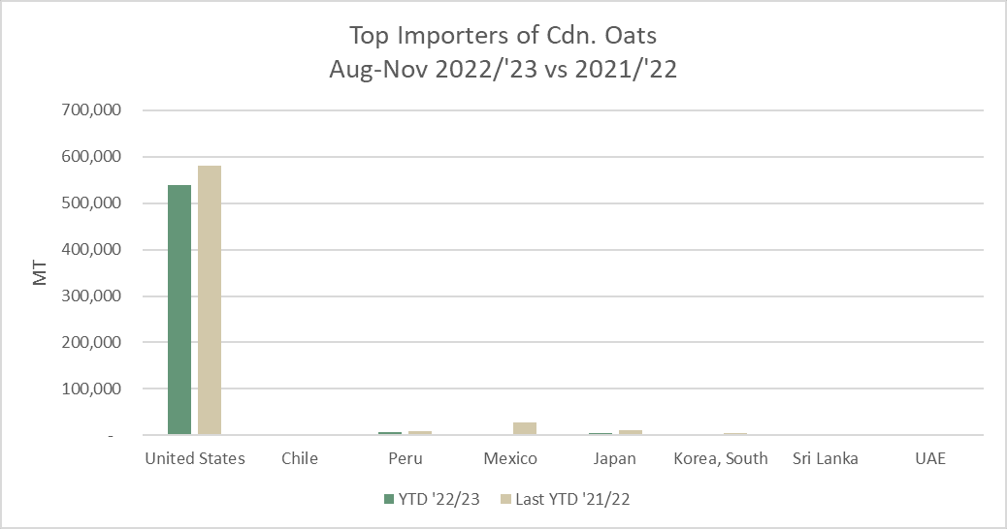
Oat export summary
US represents 95-99% of Cdn oat mkt
US prod’n: up ~260k mt to 837k mt

Slide 24
YTD oat exports

Slide 25
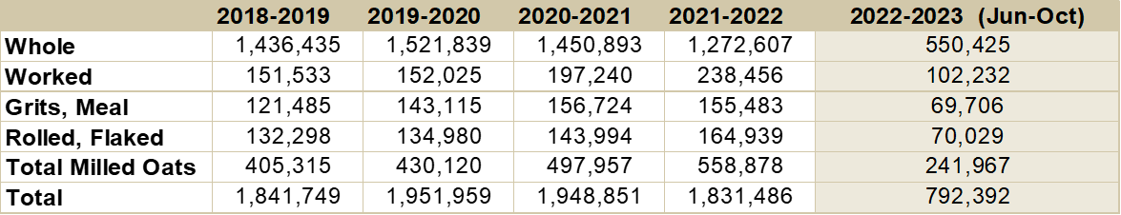
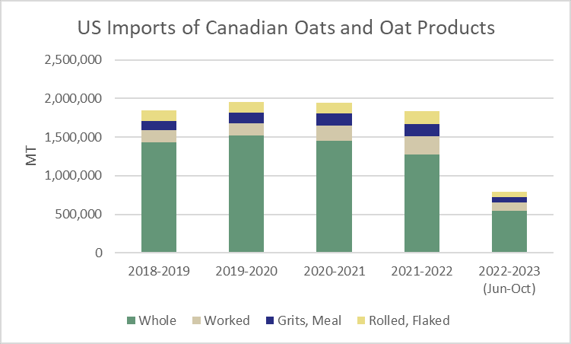
Us oat imports

Slide 26
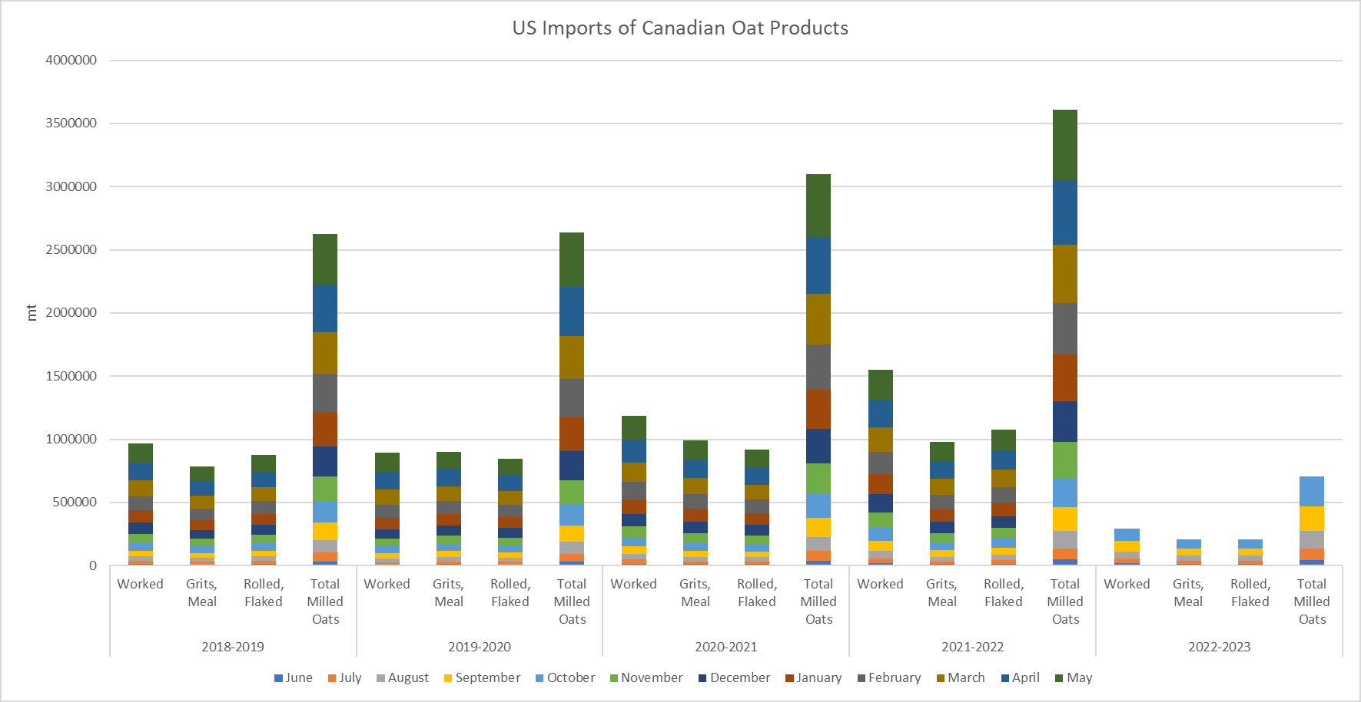

Slide 27
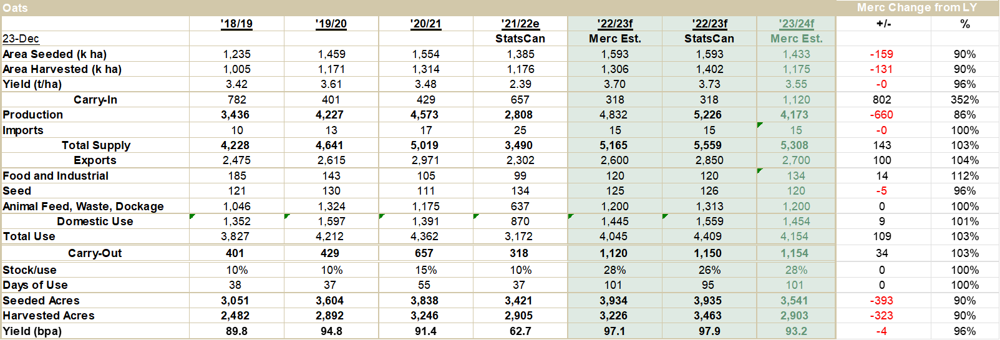
Cdn. Oat Balance Sheet for ‘23/24
Notes:
Domestically, the only way to decrease feed usage of oats and secure supply for the expanding oat product market is if there is a sustained and long-term rise in oat prices vis-à-vis those of other field crops and oilseeds.

Slide 28
Ending stocks !!
‘23/24:
basis 15% acreage drop
2.7 mlnmt exports
1.5 mln mt dom. D
~855k mt C/O

Slide 29
Current status oat market
Chic. Futures: High $8.04 Apr. ‘22; Current: $3.54 Dec. ‘22; v. thin trade
Cash oat current px SK: $4.50-$5.00/bu (dfrd); $5.25-5.50/bu MB
StatsCan Dec. 2 oat prod’n number: 5.2 mln mt
  (+572k mt from Sept. est.; v. 4.7 mln mt trade expectation)

Slide 30
What drives oat prices?
Demand by oat mills in Cda. & USA
  ~ six Cdn. Co’s which source/ handle oats
  ~ six US oat mill buyers
Demand for US horse feed
  ~ two horse oat buyers
Wheat, corn & barley prices w.r.t. feed values and acreage competition
US$ exchange rates
Freight

Slide 31
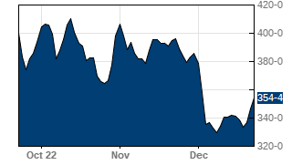
Oat futures:
- Very thin

Slide 32
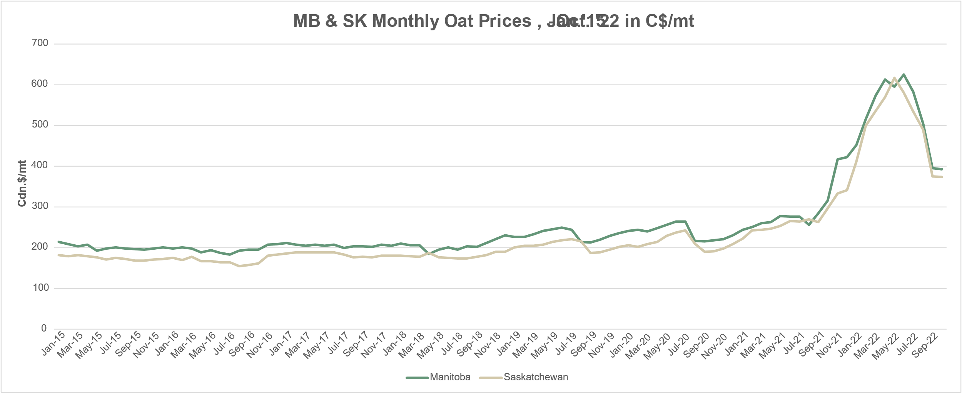
Monthly cash oat prices in MB & SK
Tend to have seasonal highs in J/F & July

Slide 33
Monthly Oat prices in MB & SK
Nov.’22 Dec.’22

Slide 34
Comments oats
The final StatsCan oat production estimate came in significantly bigger than expected last week at 5.2 mln mt, the highest production level in five years.
The milling oat market seems to filled into the J/F, so bids are now for deferred shipping windows at ~$4.50/bu.
Feed oat bids seem to have faded to around $3.50/bu, but vary greatly between Co’s.
Oat prices will need to rise, but the abundance of supply will limit upside. There is likely a maximum of $0.50 upside, as there is lots of supply, but oat prices will need to improve into springtime to try and buy acres. At current prices, there is little incentive to plant oats compared to wheat.

Slide 35
Discussion & Questions
Contact:
mboersch@mercantileventure.com
www. mercantileventure.com

